Slide 1
Delivery Types
Mango
How to bring us forward!
April 2025

Slide 2

Training are not an expense, but an investment in Human Capital
Transcom
Roy H Williams, 2001
|

Slide 3
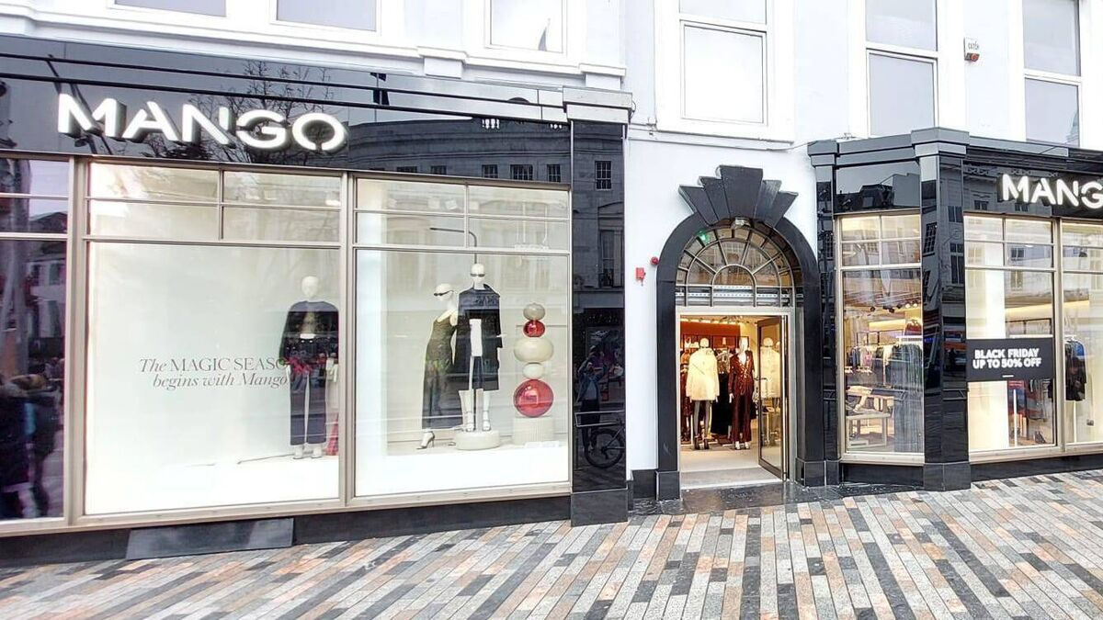

Introduction
Mango offers multiple delivery options depending on various factors.
The destination country is the main determinant of the available shipping methods.
Other factors include:
Specific city or region (e.g., urban vs. remote areas)
Which website is used (Mango.com or Mangooutlet.com)
Operational issues like carrier capacity, sales events, or warehouse delays
Because delivery options can change, checking the website regularly is essential to avoid miscommunication.
|

Slide 5
Geographic and Platform Variability
Delivery availability can differ within the same country.
Example: Pick-up in store is available in mainland Spain and Balearic Islands, but not in Ceuta and Melilla.
In the UK, 24-hour delivery may be offered in London but not in rural areas.
Delivery methods may also vary depending on whether customers order from:
Mango.com (main site)
Mangooutlet.com (outlet site)
|

Slide 6
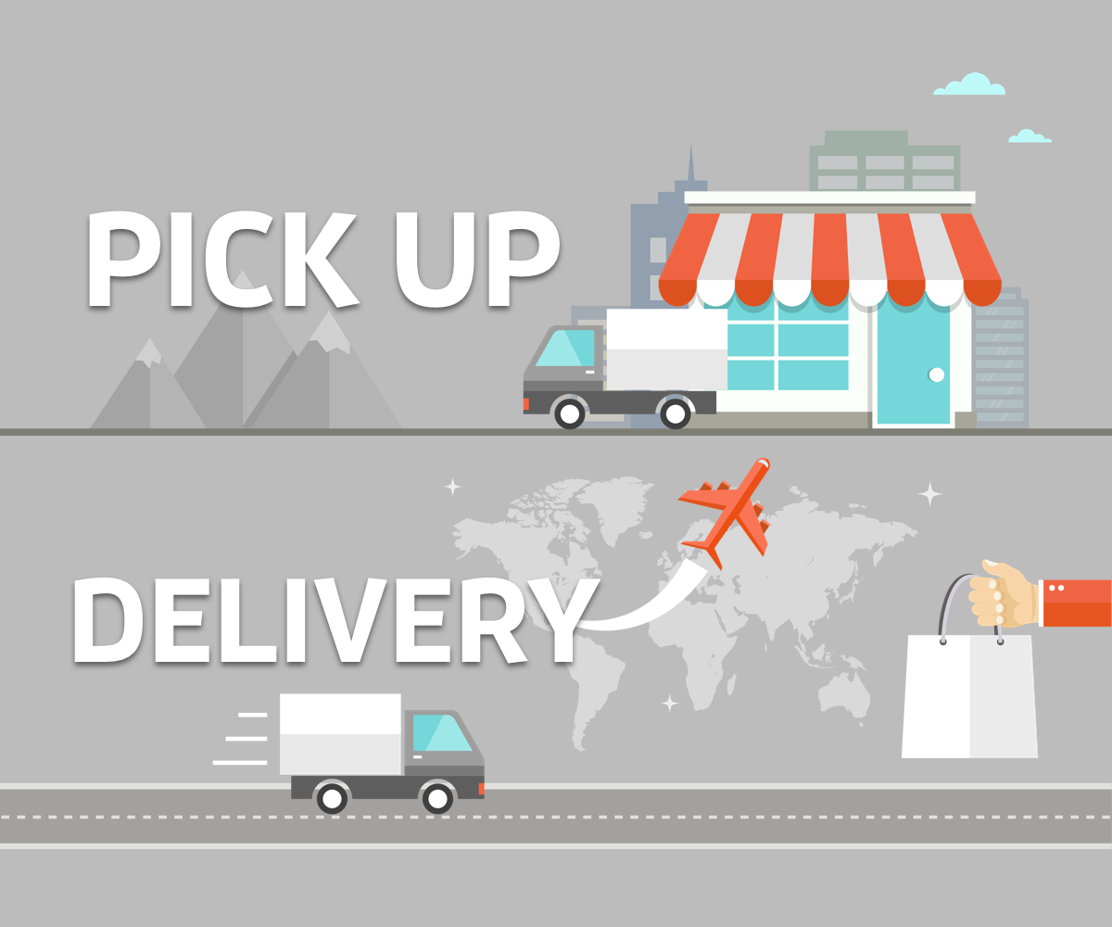

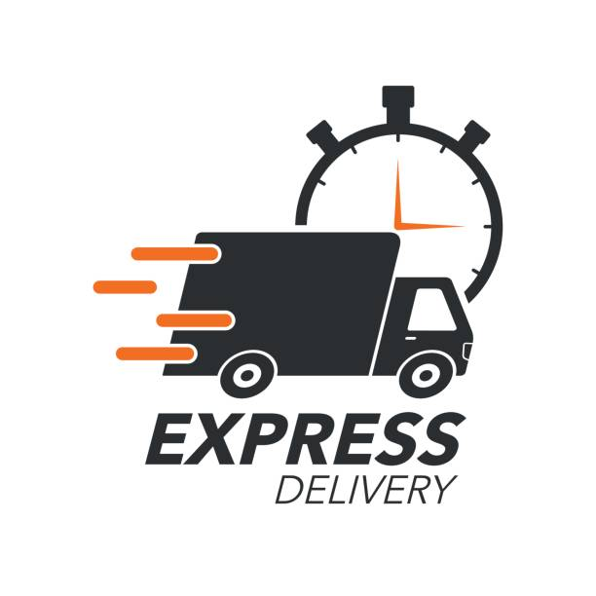
Delivery Types Overview
Mango provides different delivery options tailored to customer needs and logistics capabilities:
Pickup in Mango Store – Collect your order at a physical Mango retail location.
Pickup at a Collection Point – Receive your order at a nearby authorized third-party drop-off point.
Home Delivery – Have your order delivered to your home address.
24-hour / Urgent / Express Delivery – Fast shipping for home addresses in specific areas.
Internal Pickup for Mango Employees – Special options available only to Mango employees working at HQ or logistics centers.
|

Slide 7
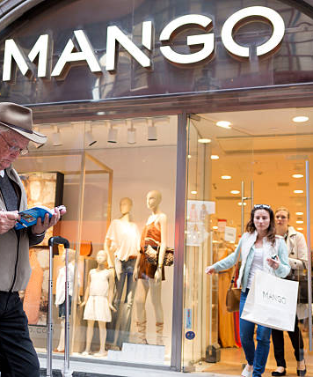
Pickup in Mango Store
Standard delivery only (no express or urgent options).
Customers choose a participating Mango store at checkout.
They can search by postal code, city, or address.
Not all stores offer this option — eligible locations are shown during purchase.
An automatic email is sent when the package arrives at the store.
Collection period is usually 15 days (may vary by country).
To collect, customers provide:
Order number
Valid ID
If not collected in time, the order is refunded via the original payment method.
|

Slide 8

Pickup at a Collection Point
Only standard delivery is offered.
Similar process to store pickup, but collection is at third-party drop points.
Customers can search for available collection points during checkout.
Not all locations accept Mango orders — updated list shown at time of order.
Customers receive an email when their package is ready.
Collection window: Typically 7–10 days.
Required at pickup:
Notification email or order number
Valid ID
If not collected, it’s returned to the warehouse and refunded.
|

Slide 9

Home Delivery
Offers standard, urgent, express, or 24-hour shipping in some areas.
Carrier policies vary:
Some may leave packages in a safe place if the customer is absent.
Others require the delivery to be signed for by the customer or a neighbor.
Some can only deliver to the person who placed the order after confirming a time.
Delivery policies are dictated by carrier agreements with Mango.
It’s crucial to know each carrier’s rules to:
Accurately inform customers
Identify contract breaches
Determine if a customer issue is a complaint or just a request for information
|

Slide 10
24h / Urgent / Express Deliveries
Fastest delivery options, but only available for home addresses.
Not available for stores or collection points.
Limited availability — depends on the city or region.
Delivery depends on when the order is placed:
If placed before 12:00 (Mon–Fri): processed the same day
If placed after 12:00 on Friday or during weekends/holidays: delivery is delayed
Example:
A Saturday order with 48h delivery will arrive Wednesday, not Tuesday
|

Slide 11
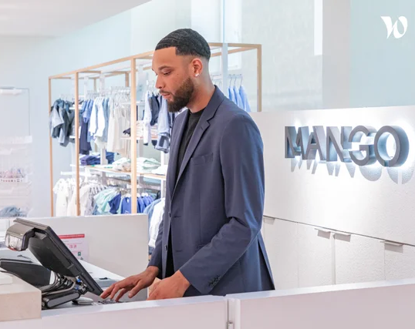
Internal Delivery – Mango Employees
Available only to Mango employees at:
HQ in Palau de Plegamans (Palau & Gallery-Hangar buildings)
Lliçà logistics center
Steps for employees:
Enter employee code in the discount field
Provide ID/passport number and first surname
This unlocks 3 employee-exclusive delivery options
Employees can contact parcel department for specific delivery hours
|

Slide 12
Key Considerations
Delivery options may be disabled:
During high sales periods (e.g., Black Friday, Cyber Monday)
Due to logistics issues or carrier limitations
It’s essential to:
Check the website regularly
Provide customers with accurate, updated info
Knowing the rules and exceptions helps prevent complaints and improves service quality
|

Slide 13
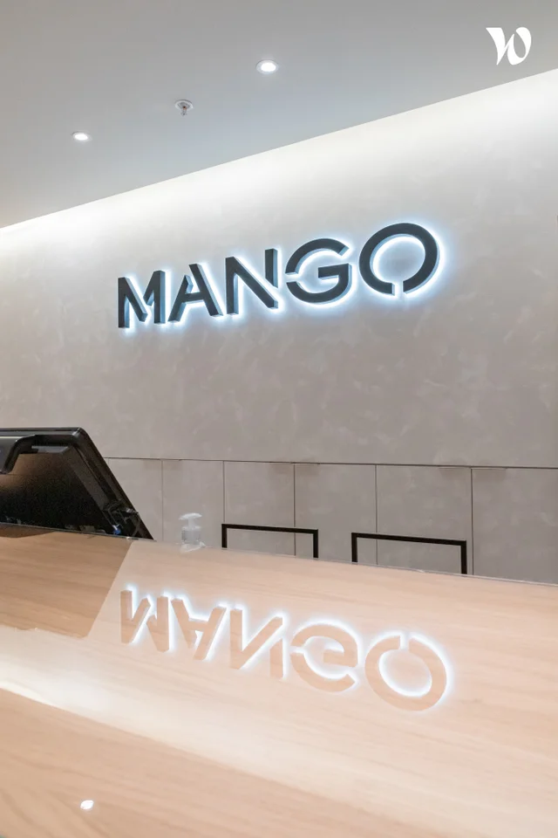
Conclusion
Delivery method selection is influenced by:
Location, website, and timing
Each method has specific rules and limitations
Be aware of:
Carrier policies
Cut-off times
Exceptions during sales or busy periods
Staying informed ensures better customer service and fewer issues
|

Slide 14
Let´s be brilliant together!
Quality and Training Team Mango and Transcom,
April 2025
|

